Slide 1
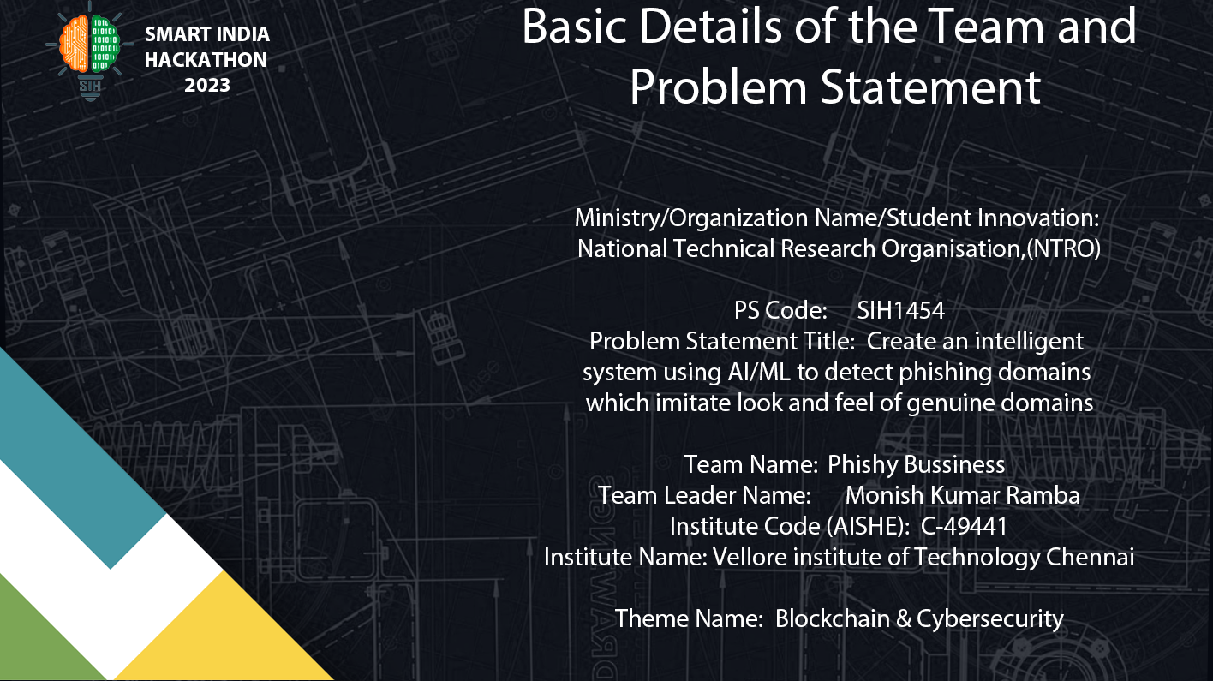

Slide 2

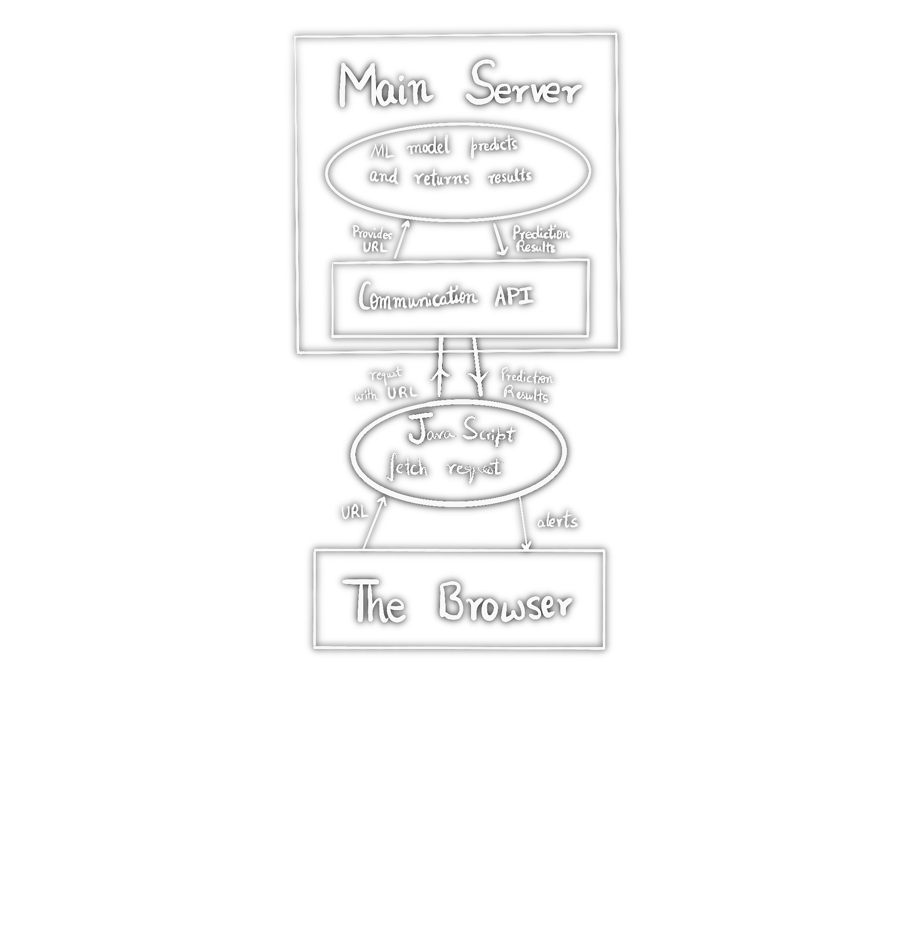
Idea/Approach Details
Our Prototype:
Our solution aims to deploy a real time phishing and other malicious url detection system for application in both android (custom browser) and web-based (web extension) environment. The functionality of our prototype can be broken down into the following steps:
The extension is using our own API to request the current URL, after which it is passed to the ML model.
The model will evaluate the probablilty score of the link to be a phishing website or not.
We then get the response using the same API and the extension pops up the response as an alert.
Describe your Technology stack here:
Python (Scikit-Learn, Pandas, Numpy, Re, beautifulsoup, joblib, etc.)
HTML/CSS/JS
JSON
FLUTTER
TENSORFLOW
FLASK

Slide 3

Idea/Approach Details
Dependencies / Show stopper:
Real time url detection using advanced and dynamic machine learning models with high accuracy guaranteeing users a secure online environment.
Custom API, built solely for rapid URL fetching and response, enabling quick alerts.
Pre-emptively checks if the webpage in itself is a hyperlink by using advanced web techniques.
In-depth feature detection of every website using web scraping to instantly extract unique features like redirects and iframes.
A convenient web extension on surface, promoting user friendly experience.
Tailor-made browser especially for mobile usage connected to our ML model, thus supporting cross platform compatibility.
Use Cases:
Privacy Protection: Quick and instant identification of harmful links on a personal scale
Our solution scans web pages in real-time upon user interaction, ensuring that users are protected from the latest threats
Comprehensive protection against a wide range of cyber threats, including phishing websites, malware and zero-day attacks.
Custom whitelist and blacklist based on user feedback system.
Our software can be integrated with any enterprise software, allowing them to defend against targeted cyber attacks and build a robust security system

Slide 4
Team Member Details
Team Leader Name : Monish Kumar Ramba
Branch : B.Tech Stream : CSE Year : II
Team Member 1 Name : Asad Hadi
Branch : B.Tech Stream : CSE Year : II
Team Member 2 Name : Aditi Mihirkumar Jo
Branch : B.Tech Stream : CSE Year : II
Team Member 3 Name : Krish Tejwani
Branch : B.Tech Stream : CSE Year : II
Team Member 4 Name : Sahil Agrawal
Branch : B.Tech Stream : CSE Year : II
Team Member 5 Name : Yash Agarwal
Branch : B.Tech Stream : CSE Year : II
Team Mentor 1 Name : Dr. Jeyamala
Category : Academic Expertise : Domain Experience :
Team Mentor 2 Name : Dr. Vatchala S
Category : Academic Expertise : Cloud Security, AI Domain Experience : 11 years

